Slide 1












Text Search based on
Hadoop/Spark
Group 36
LIN Xiaotao (Justin) 1930026081
XUE Shaojie (Jack) 1930026143
ZHU Yizhuo (Bruce) 1930004048
Ma mingze (David) 1930006138

Slide 2
Contents
01
02
03
04
Introduction
Text files collection
Indexing and ranking
Web server and interface

Slide 3



01
Text files
collection
Web resource
Text files formula
Notes:
Ok, let me firstly introduce the text collection part

Slide 4
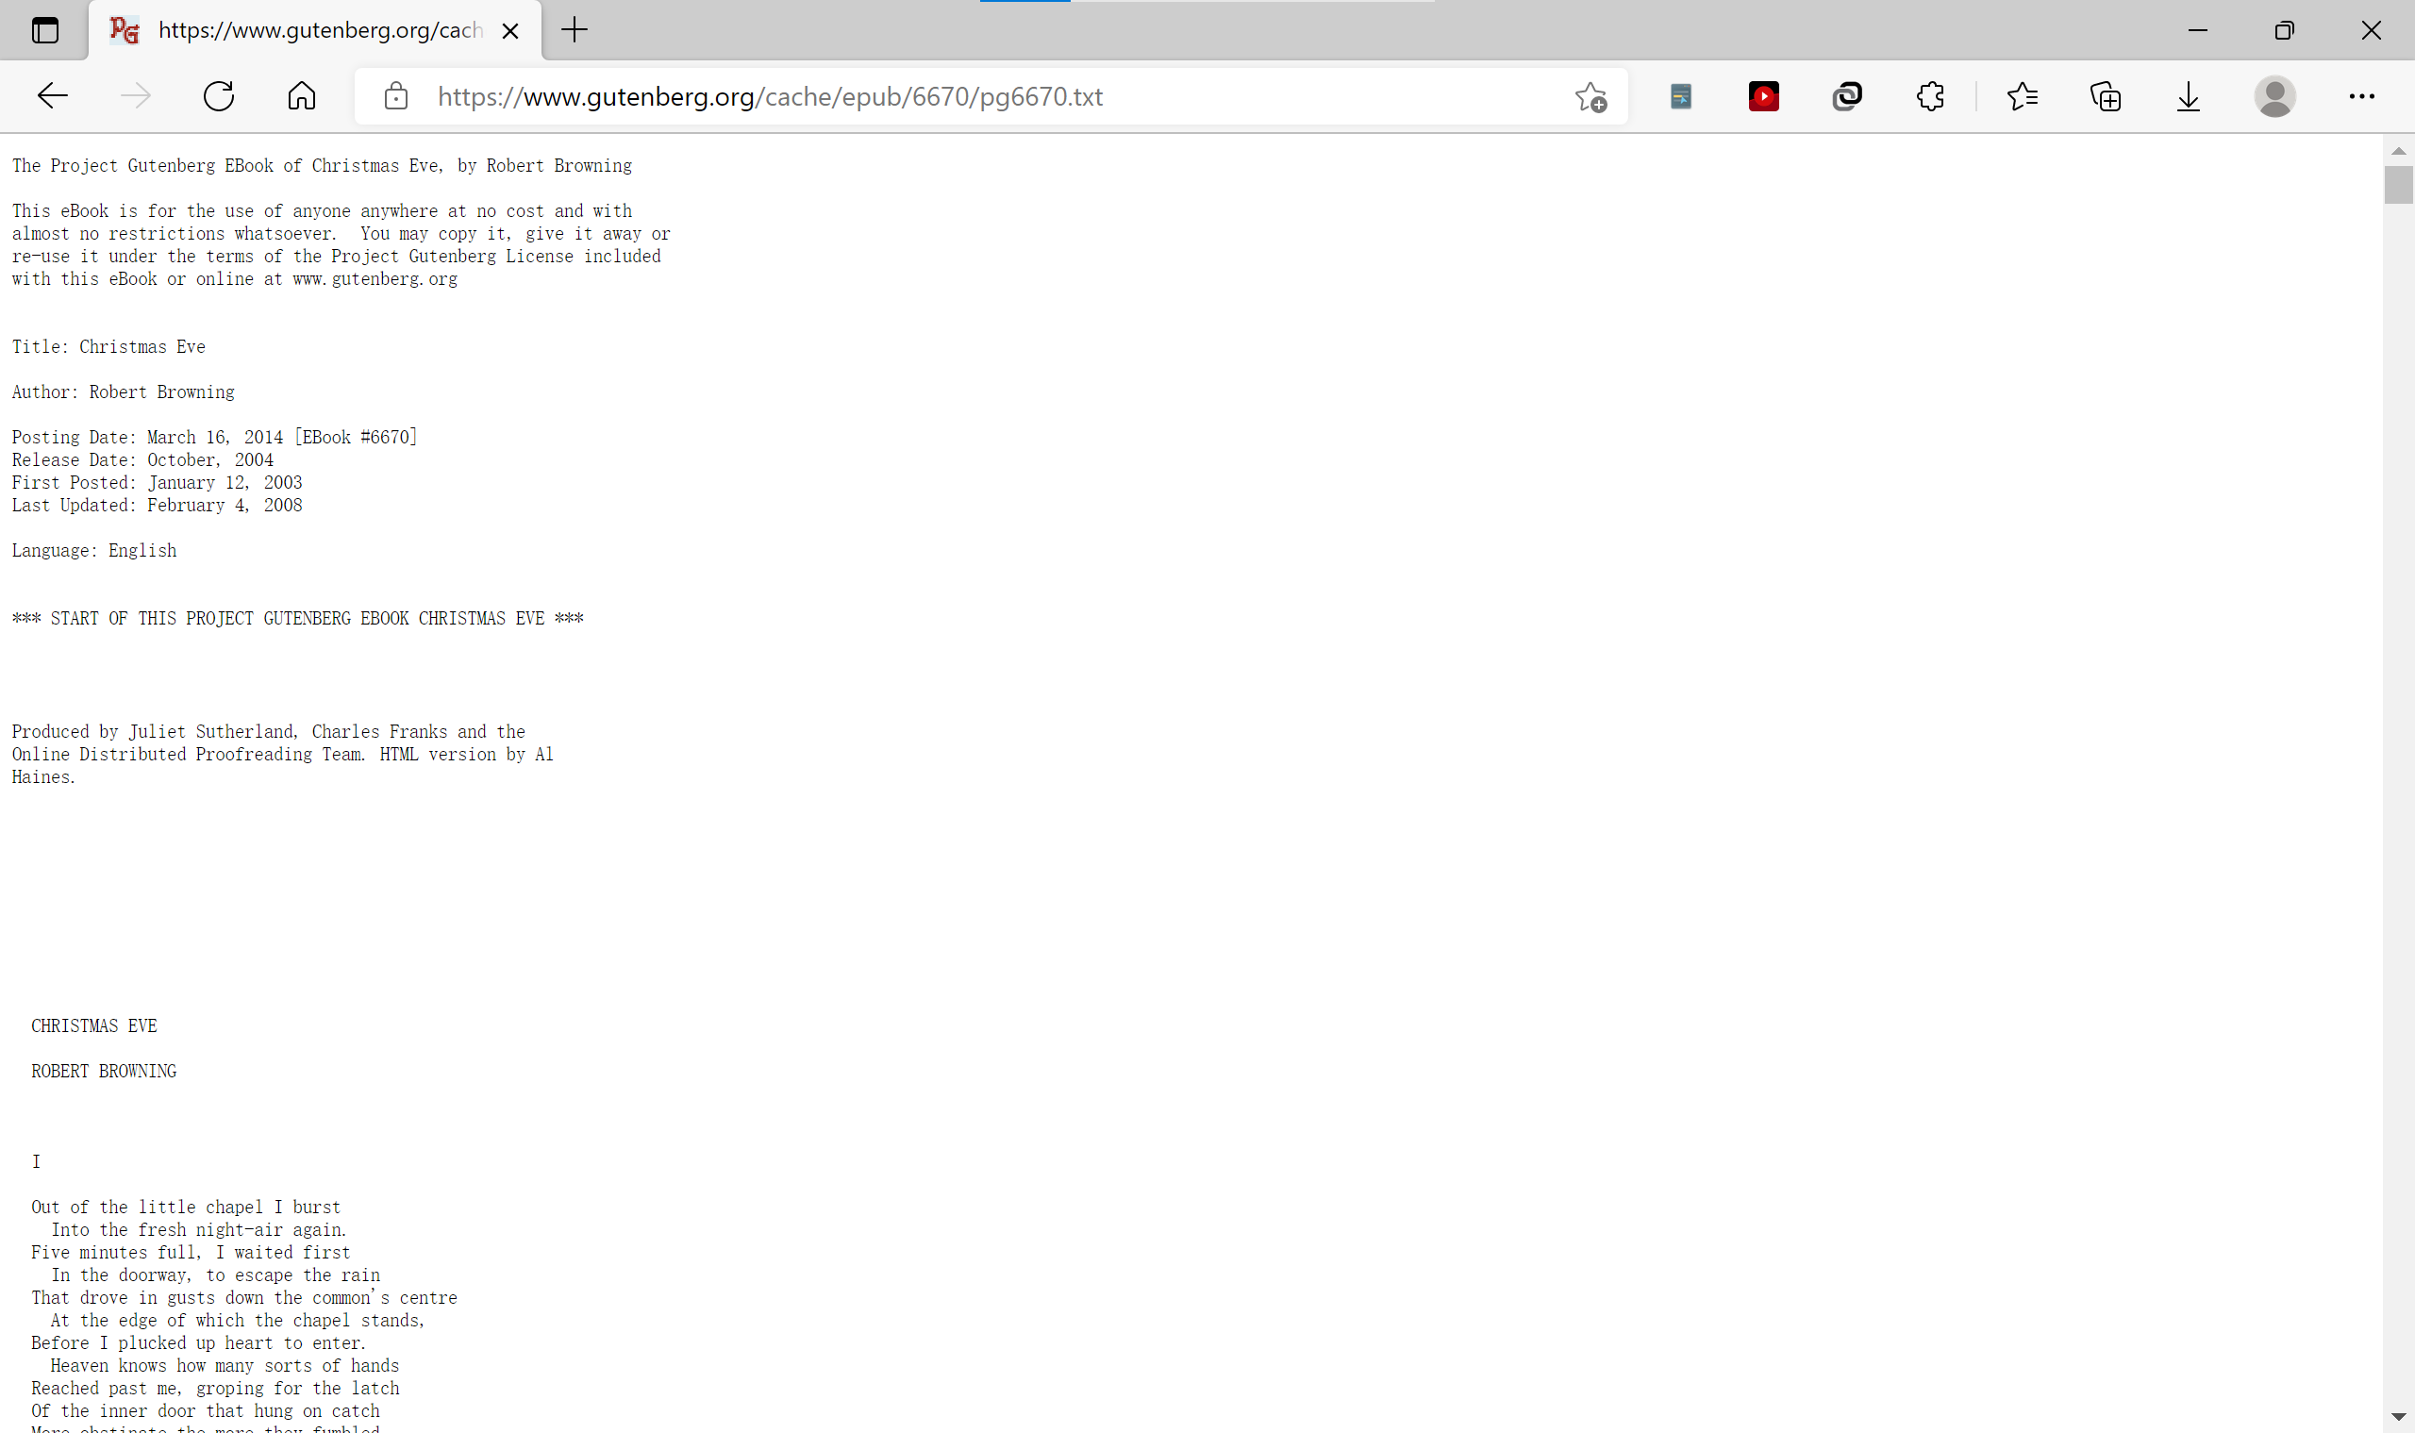

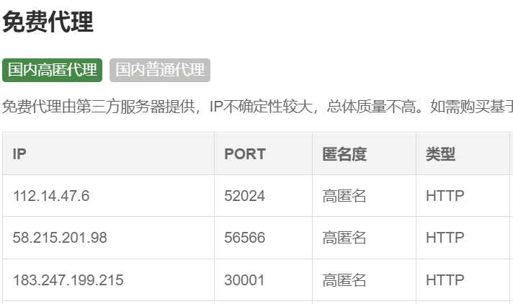
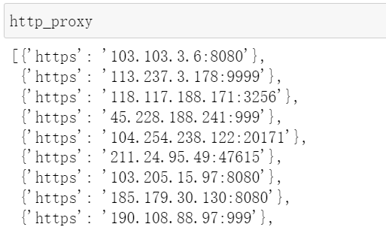
01
Text files collection
Recourses:
IP pool:
Notes:
Ok, let me firstly introduce the text collection part. We using the request package to obtain the data from the project Gutenberg, since this website may ban our IP from time to time. I manage an IP pool from the Internet. If our IP is ban by the server, we can select another IP for it.

Slide 5
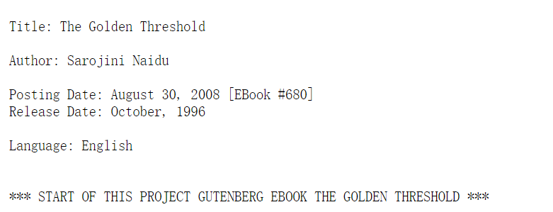
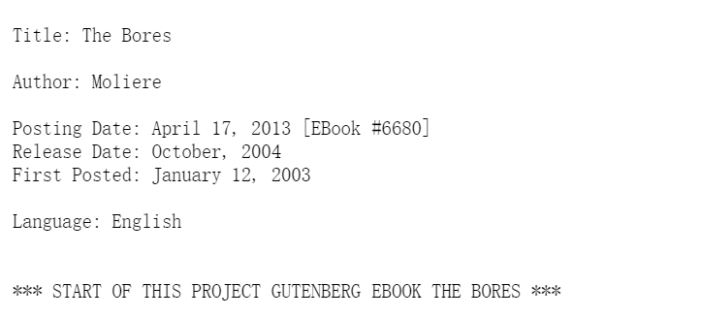
01
Text files collection
Title
: :Christmas Eve
Author: Robert Browning
Language: English
https://www.gutenberg.org/cache/epub/
6670/pg6670.txt
Title: The Golden Threshold
: Sarojini Naidu
Language: English
Author
/pg
https://www.gutenberg.org/cache/epub/680
680.txt
Title: The Bores
Author: Moliere
: English
6680
6680
Language
https://www.gutenberg.org/cache/epub/6680/pg6670
.txt
Notes:
As you can see that, the things we need is the title, author, language type and the text content. After observing this website, you can see that the text and the information is including in the webpage.

Slide 6
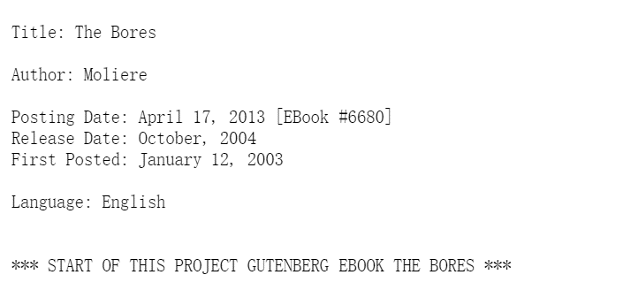
Data Storage
01
Text files collection
Title
Author
English
keep
Language
skip
Others
/pg
.txt
https://www.gutenberg.org/cache/epub/
6680
6680
Index of book
Notes:
So, we get these data from the corresponding area, which means we just detect the key word from it and we can see the url have some regular, so I just replace the index of book to take all the book. And since we just need English article, so if we get the book with not English, we will skip this article.

Slide 7
01
Data Storage
UTF-8 with BOM
Text type:
Filename:
_
.txt
UTF-8
Text files collection
Title
Author
Unacceptable notation
Title:
Space
1. Index
2. Title
3. Author
4. Text
csv File:
Multiple authors
Author:
Separate by “&”
Notes:
As for the processing for the data. We set the text type from UTF-8 with BOM to the UTF-8. Then, we replace the notation in title which is not allowed to use such as “?” to the space. And if a book has multiple authors, we separate the author by “&” and put it to the name of txt.

Slide 8









02
Index and
ranking
Document
Design of position
Third-party library

Slide 9

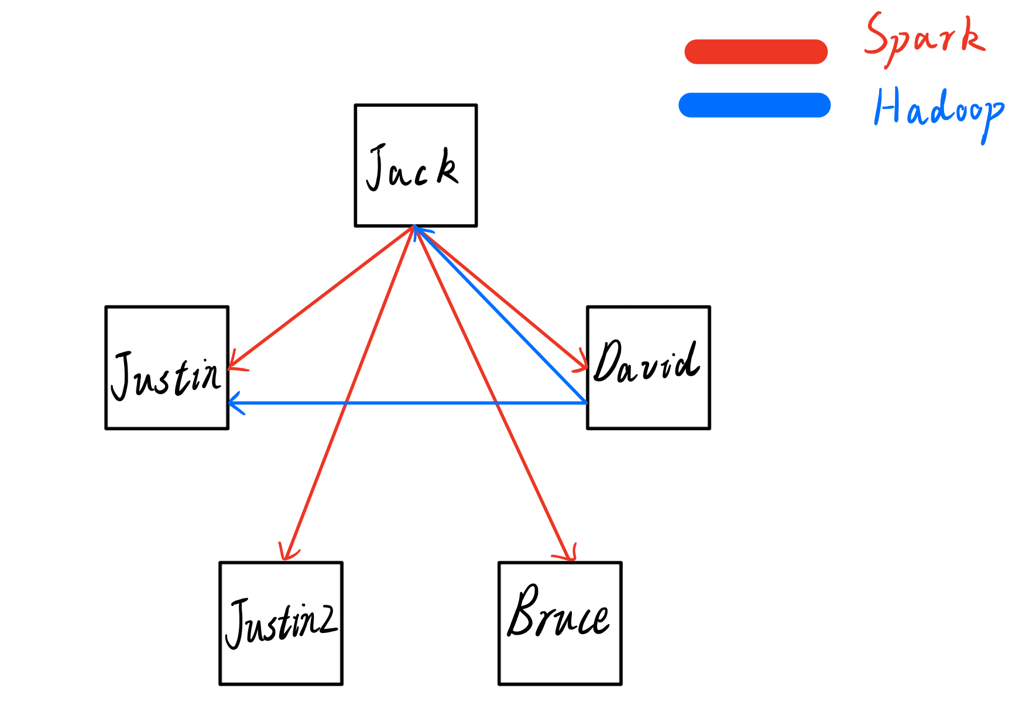
Structure of Cluster
Worker distributed
Two master
Spark master: Jack
Hadoop master: David
Notes:
Now I will introduce the structure of Cluster.
The pictures above shows the structure of cluster. Firstly, in our project, we totally have 5 virtual machines. For Spark cluster and Hadoop cluster, we use the different master.
For Hadoop cluster, we use “David” to be master, and “Justin” and “Jack” to be slave. For each slave, they stored a part of data.
For Spark cluster, we use “Jack” to be master, and “Justin”, “Justin2”, “Bruce” and “David” to be the worker. For each worker, they calculate a part of data. And the result after calculating by worker will be stored in local, if the workers don’t submit the result to the HDFS.

Slide 10
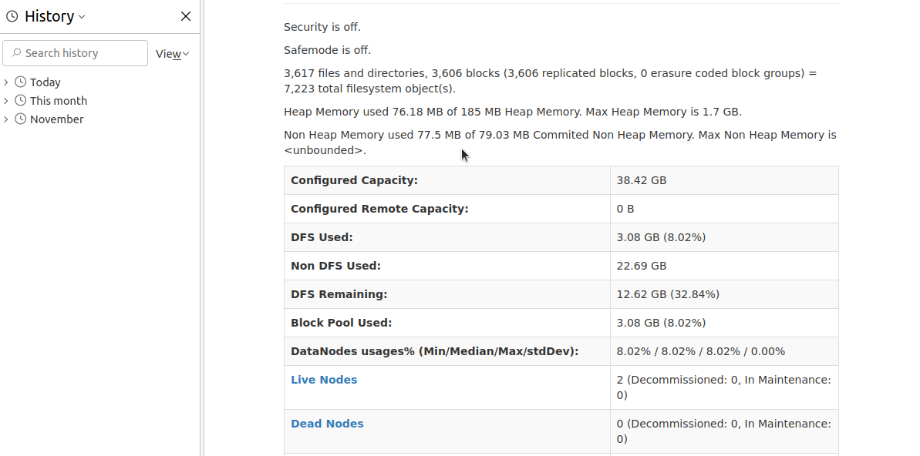
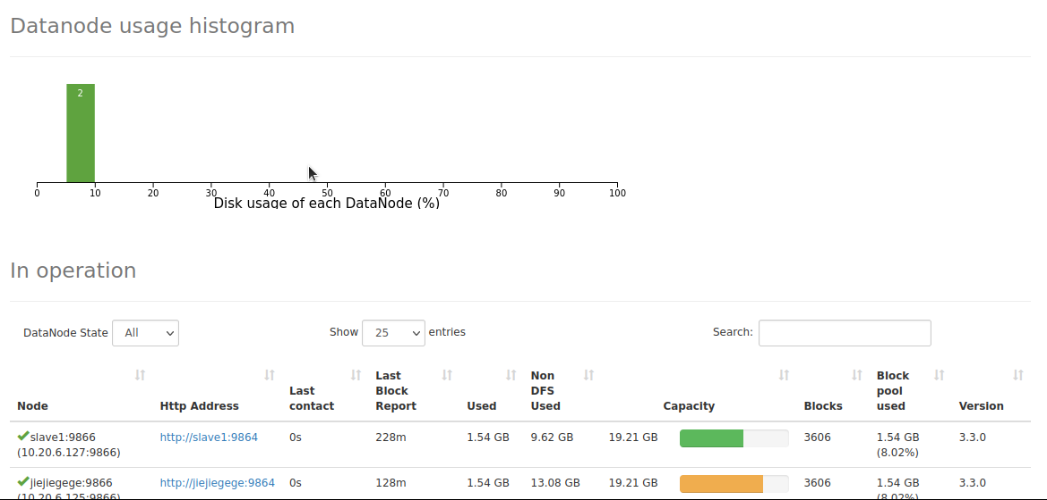
Preparation
HDFS
Notes:
Here shows the HDFS pages.
And the Live Nodes are two, it means that set up Hadoop cluster successfully.

Slide 11
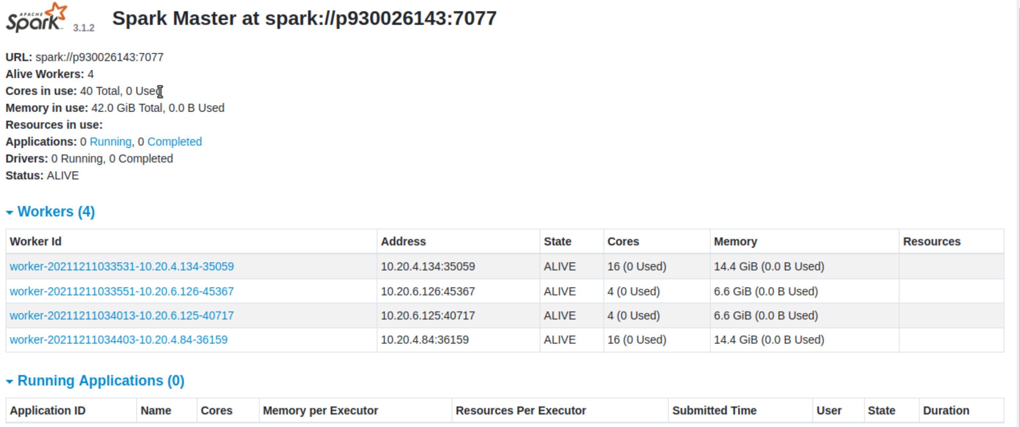
Preparation
Notes:
Here shows the Spark pages.
And in workers table, it is obvious that our four worker are alive. It means the Spark cluster is set up successfully.

Slide 12
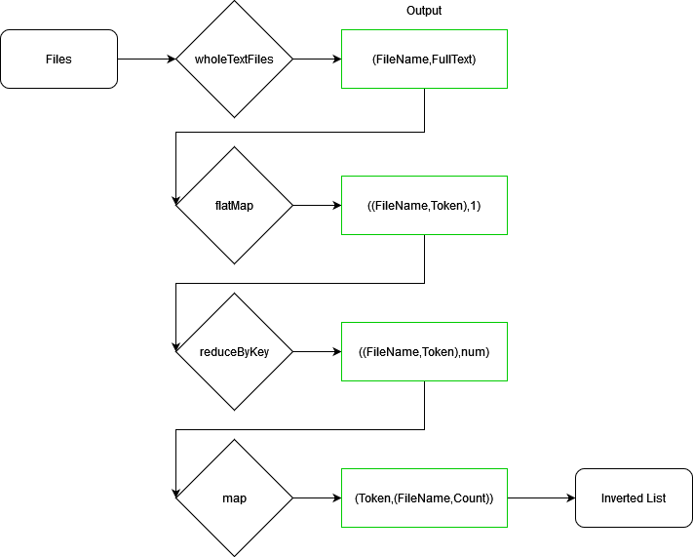
Inverted Index
Definition
Two Parts
Word dictionary
inverted file
Notes:
Definition:
The inverted index is an indexing method that is used to store a mapping of the storage location of a word in a document or a group of documents under a full-text search. It is the most commonly used data structure in document retrieval systems. Through the inverted index, you can quickly get a list of documents containing this word according to the word. The inverted index is mainly composed of two parts: "word dictionary" and "inverted file".
Process:
This is the process of calculating Inverted Index.

Slide 13
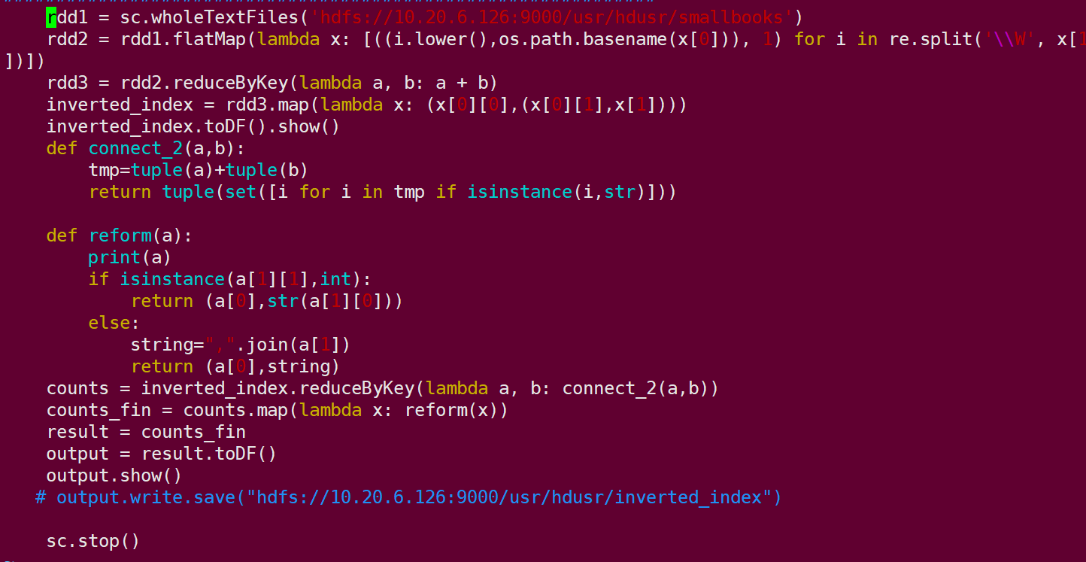
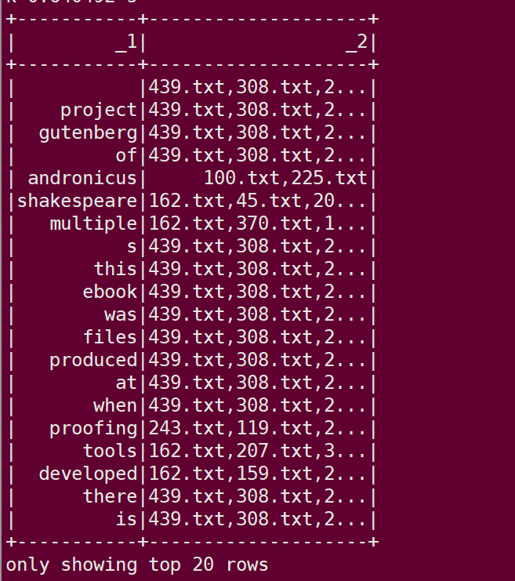
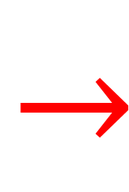
$$→$$
Notes:
Now I will the show codes and results.
Left graph show the code of Inverted Index. And right graph shows the result of Inverted Index. The first column is word, the second column is file containing the word.

Slide 14
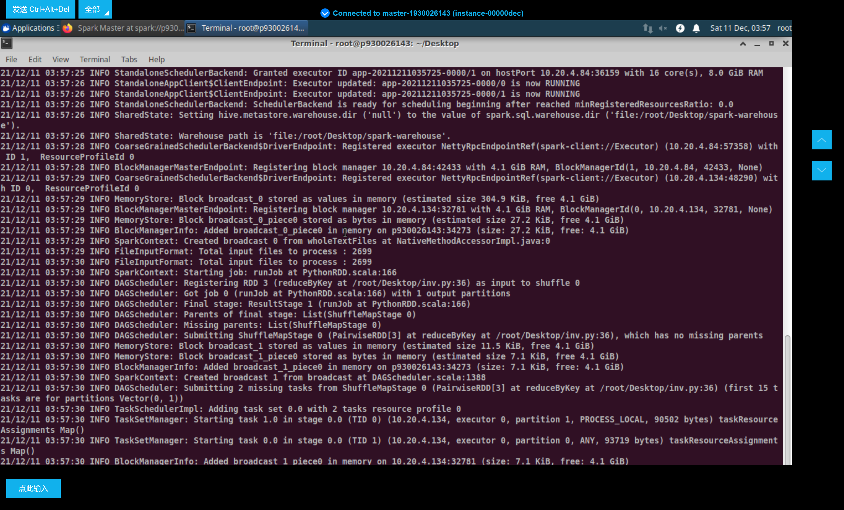

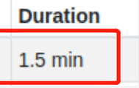
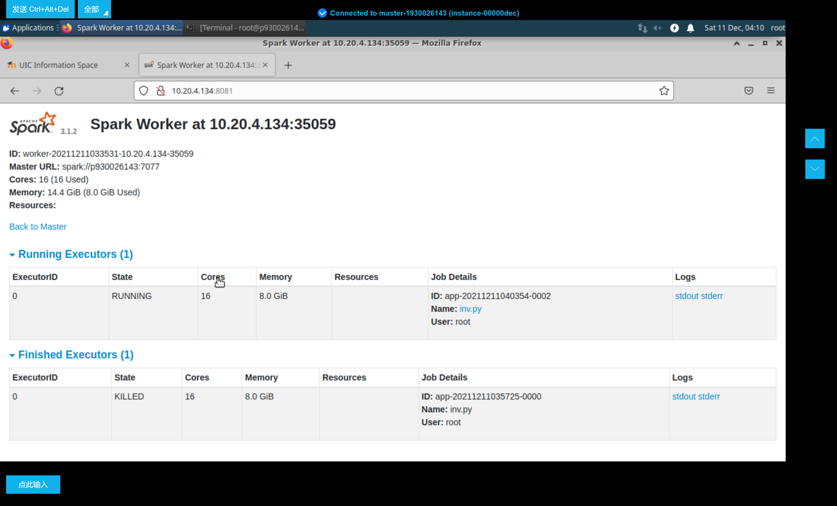
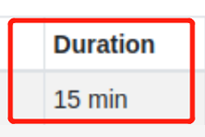
Index and ranking
Inverted index
cluster
Master
Time cost
100M
1G
Notes:
Here shows the time cost of Inverted Index for Cluster..
The Spark cluster running 100M files spends 1.5 minutes.
The Spark cluster running 1G files spends 15 minutes.

Slide 15
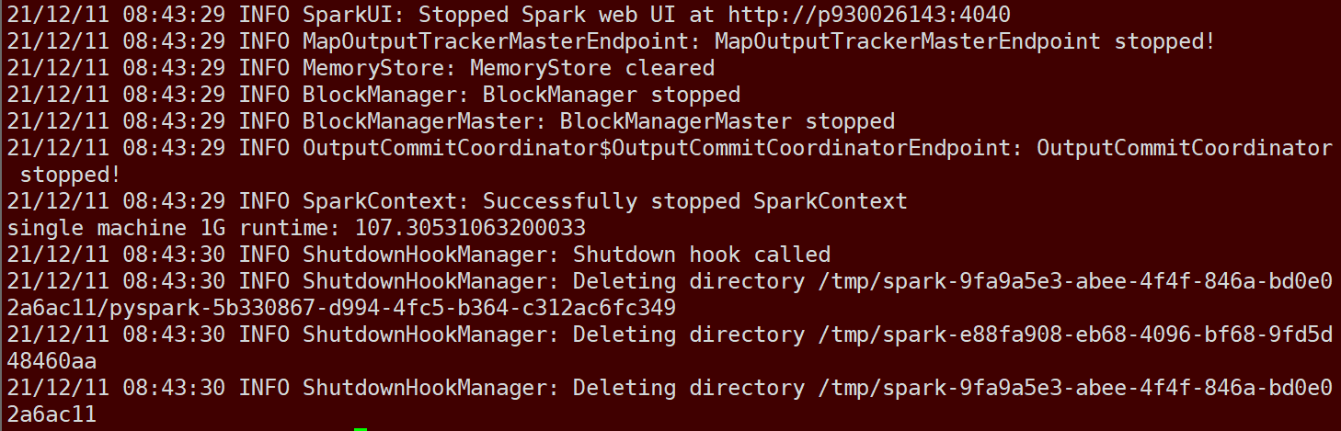
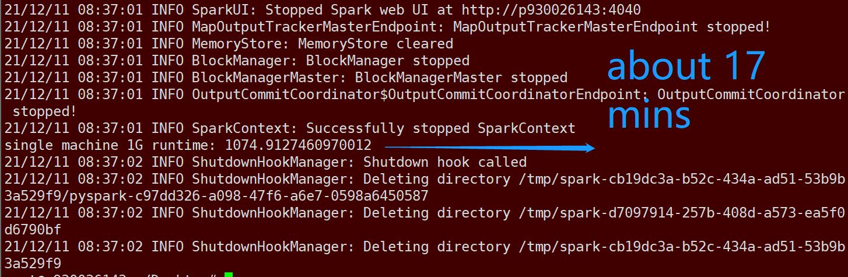
Invert index
Single machine
100M
107s
1G
17min
Notes:
Here shows the time cost of Inverted Index for one machine.
One machine running 100M files spends about 1.78 minutes.
One machine running 1G files spends about 17.91 minutes.

Slide 16
Inverted Index
Comparing
Time | Cluster | Single
100M | 1.5min | 1.78min
1G | 15min | 17.91min
Notes:
After comparing, we can find the Spark cluster has stronger ability of calculation.

Slide 17
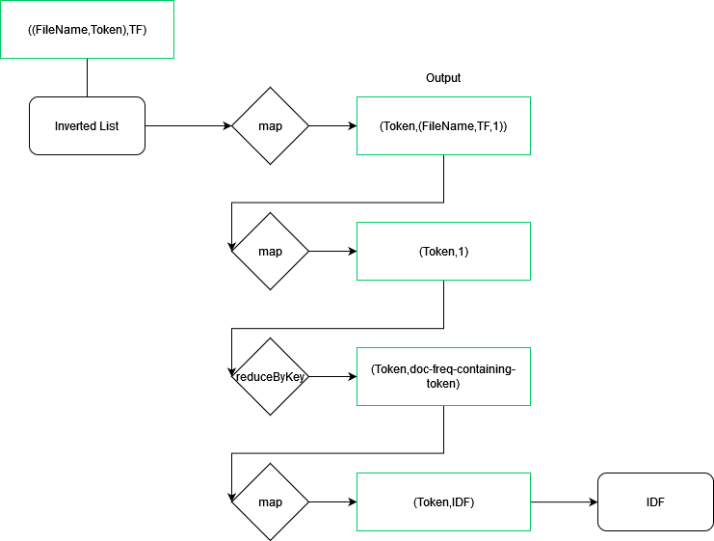
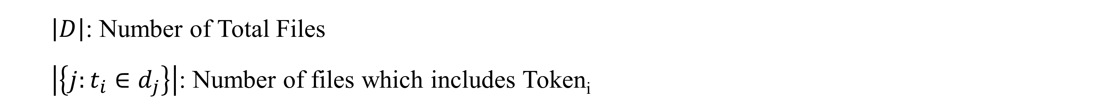
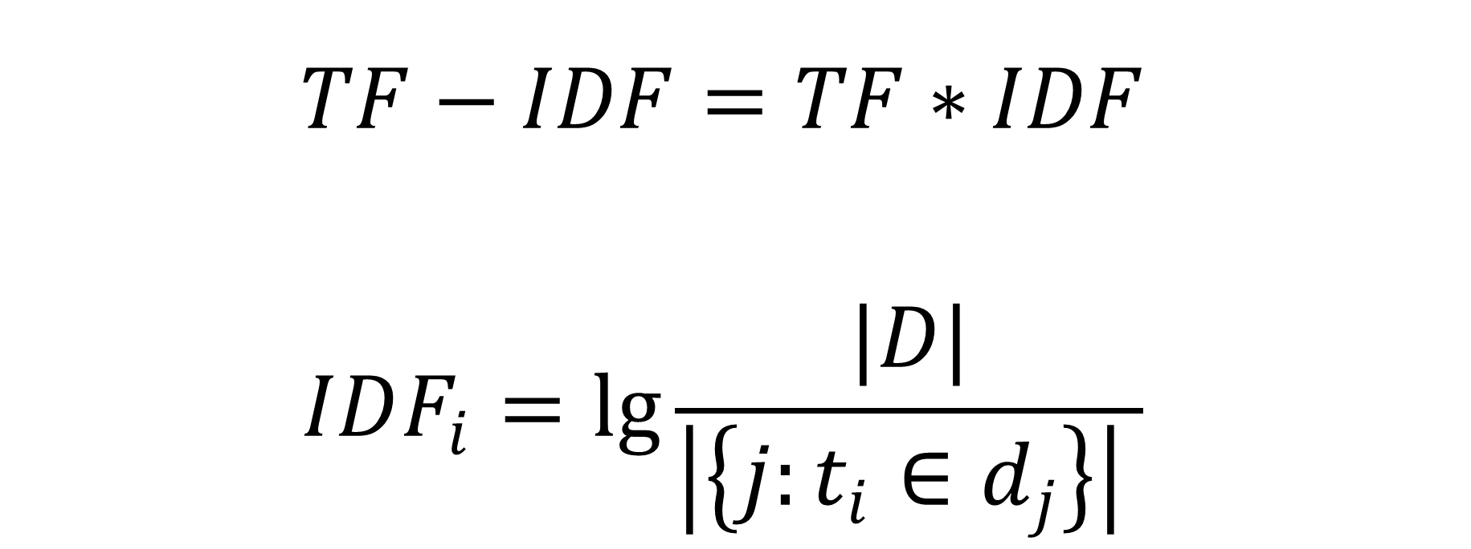
TF-IDF
Definition
$$TF−IDF=TF∗IDF$$
$$IDF_{i}=\lg{\frac{|D|}{\left|\left\{j:t_{i}∈d_{j}\right\}\right| }}$$
$\left|D\right|$: Number of Total Files
$\left|\left\{j:t_{i}∈d_{j}\right\}\right|$: Number of files which includes Token­_{i}
Notes:
Definition;
TF-IDF is a commonly used weighting technique for information retrieval and data mining. TF is Term Frequency, and IDF is Inverse Document Frequency. TF-IDF is a statistical method used to evaluate the importance of a word to a document set or a document in a corpus. The importance of a word increases in proportion to the number of times it appears in the document, but at the same time it decreases in inverse proportion to the frequency of its appearance in the corpus.
The following formula will help us calculate TF-IDF.
Process:
This is the process of calculating TF-IDF.

Slide 18
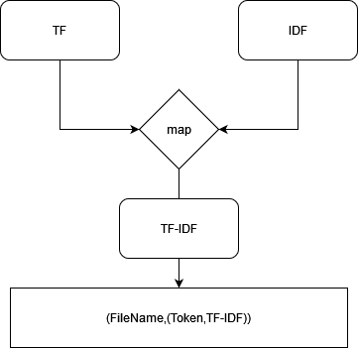
TF-IDF
Merging
Notes:
After your get TF and IDF. Then just join them to get tf-idf.

Slide 19
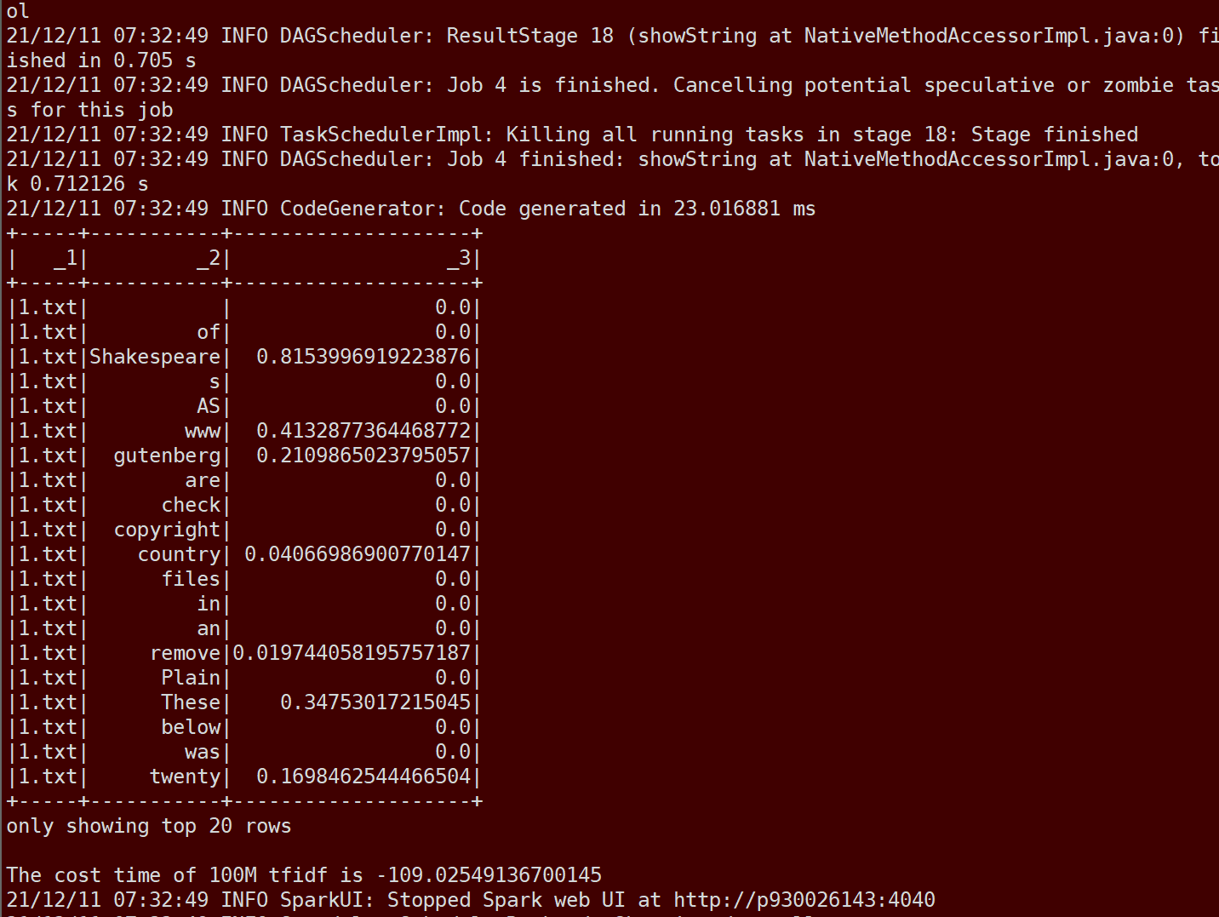
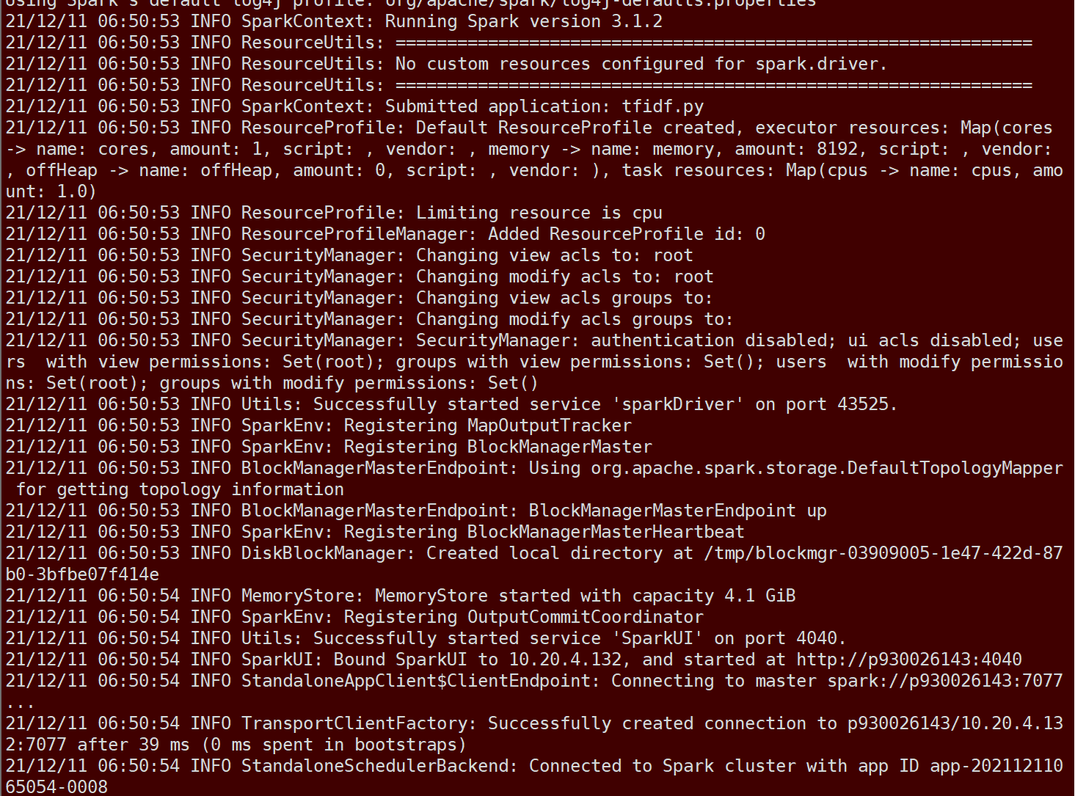
TF-IDF
Cluster
100M
109s
1G
20min
Notes:
Here shows the time cost of TF-IDF for Cluster..
The Spark cluster running 100M files spends 1.82 minutes.
The Spark cluster running 1G files spends 20 minutes.
.

Slide 20
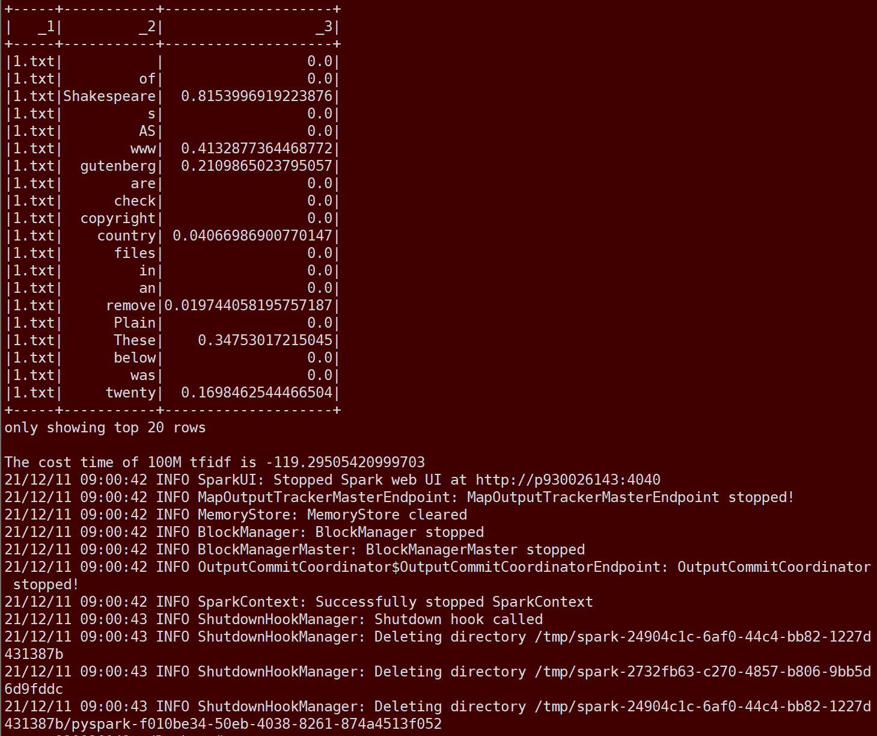
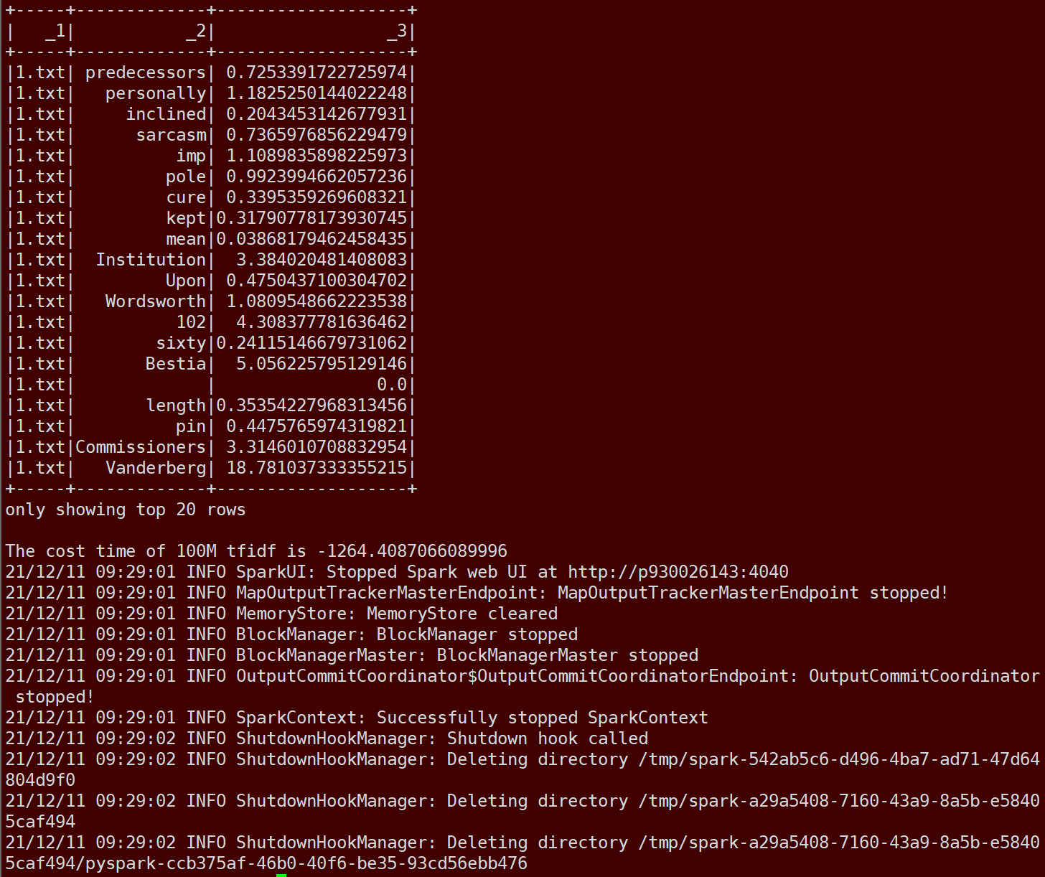
TF-IDF
Single machine
100M
107s
1G
20min
Notes:
Here shows the time cost of TF-IDF for one machine.
One machine running 100M files spends about 1.98 minutes.
One machine running 1G files spends about 21.1 minutes.

Slide 21
TF-IDF
Comparing
Time | Cluster | Single
100M | 182min | 198min
1G | 20min | 21.1min
Notes:
After comparing, we can finf the Spark cluster has stronger ability of calculation.

Slide 22
Problems
Memory
spark-submit --executor-memory=8g --driver-memory=8g /root/Desktop/inv.py
Notes:
I will introduce problems we faced.
The problem is memory problem.
Let me give a brief introduction.
Brief Introduction:
First, we run 100MB files on jupyter and there will be no problems, but when your file size reaches 1GB, it will report an error.
Solving:
The default running memory of spark is only 2g, but it is not enough for map reduce of large files. It is easy to cause memory overload, so we transfer the file to the local and use the command line to run the following command to submit the task, here we set the running memory and successfully solved this problem.

Slide 23
03
Web server and
ElasticSearch
Bitwise Operation
Function Operation

Slide 24







Thank you!
THANKS FOR YOUR LISTENING
Group 6

